Slide 1

Namrata Bastola
Rikita Gharti
Subash Gurung
R.a.mohan Tiwari

Slide 2
Introduction
What is AttendifyPlus?
A modern, web-based attendance and productivity management system designed for educational institutions:
Provides an advanced, secure, and real-time attendance system.

Slide 3
Key Features & Benefits
Real Time Attendance Recording.
QR Based System For Taking Attendance.
Real-Time Analytics Dashboard.
Prevent Proxy Attendance.

Slide 4
Problem statements
Manual Attendance Tracking Issues.
Inadequate Real-Time Insights.
Proxy Attendance.
Lack Of Transparency.

Slide 5
Objectives
Reliable Attendance Recording.
Real-Time Analytics Dashboard.
Prevent Proxy Attendance.
Save Time And Increase Efficiency.

Slide 6
Background Study
Research & Project Selection
Identifying Inefficiencies In Manual Attendance.
Growing Need For Automation.
Key Issues In Current Attendance Process
Time-Consuming Manual Entry.
Human Errors and Proxy Attendance.

Slide 7
Requirements
User Requirements
Admins: Manage teachers, student, subjets and reports.
Teachers: Mark attendance, reports, subjects, upload materials and assignments.
Students: Check assignments, materials, attendance and scan qr.

Slide 8
Requirements
Functional Requirements
User Management
Attendance Management
Assignment Management
Study Materials

Slide 9
Requirements
Non-Functional Requirements
Performance
Scalability
Reliability
Maintainability

Slide 10
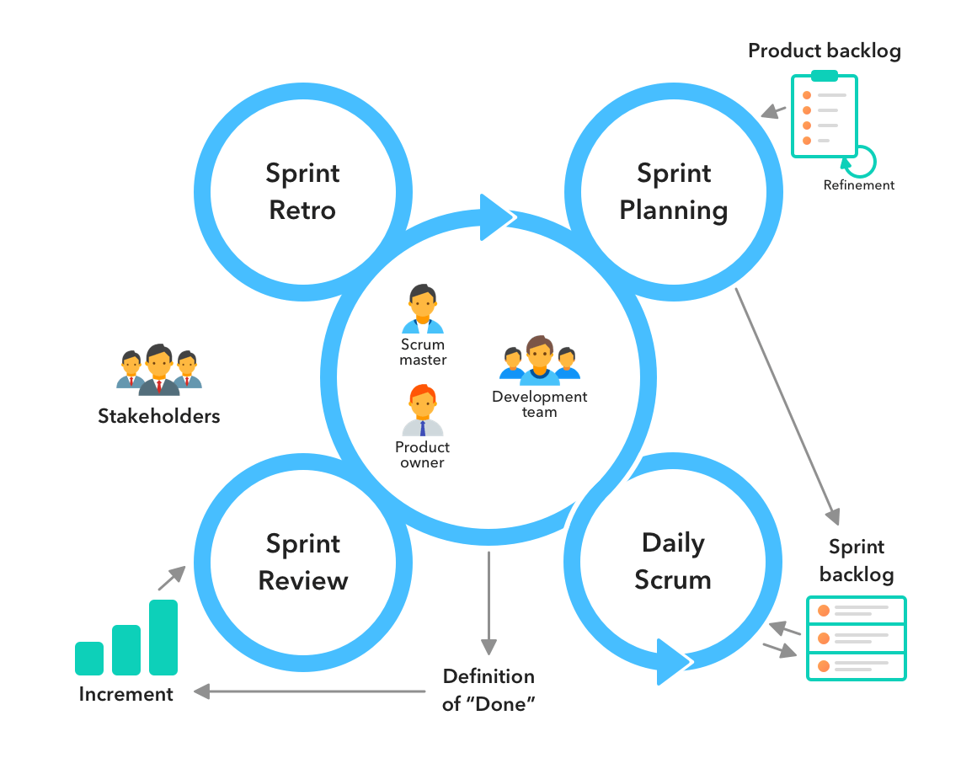
Methodology
Agile Scrum Approach:
Weekly sprints with defined tasks
GitHub for version control and collaboration
Peer review for each module before integration
Testing at every major feature milestone

Slide 11
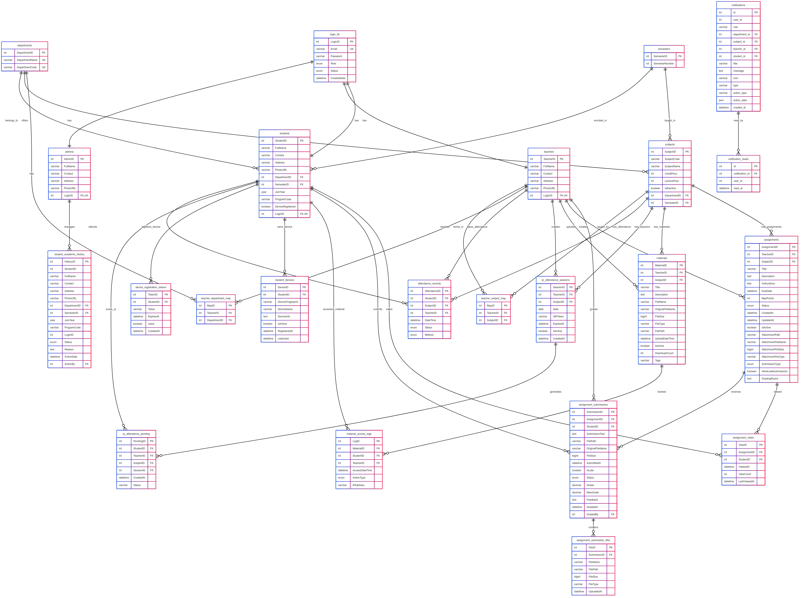
Er diagram

Slide 12
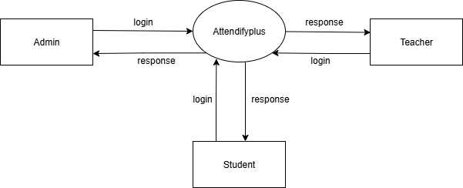
Data FLow Diagram
Fig: DFD Level O

Slide 13
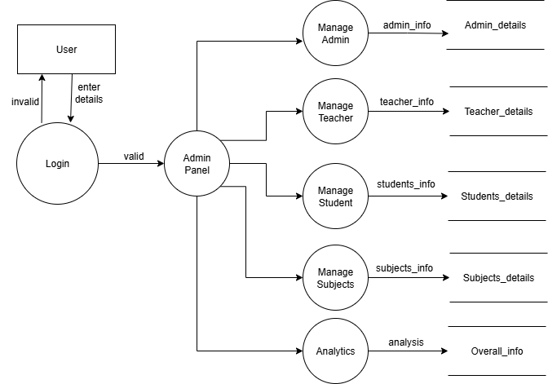
Data FLow Diagram
Fig: DFD level 1 for admin

Slide 14
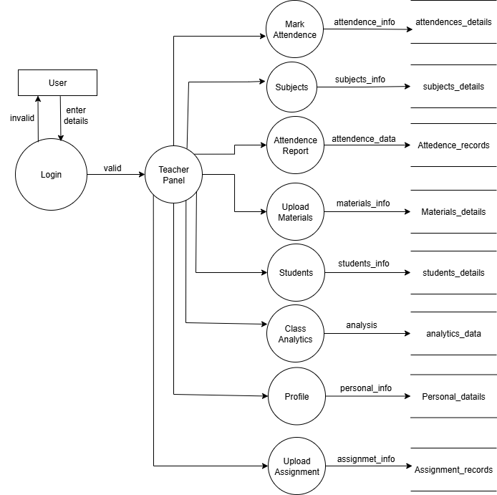
Data FLow Diagram
Fig: DFD level 1 for teacher

Slide 15
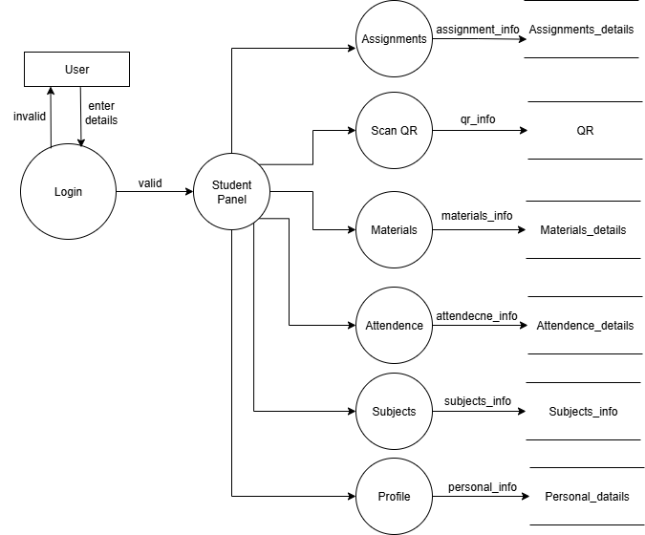
Data FLow Diagram
Fig: DFD level 1 for student

Slide 16
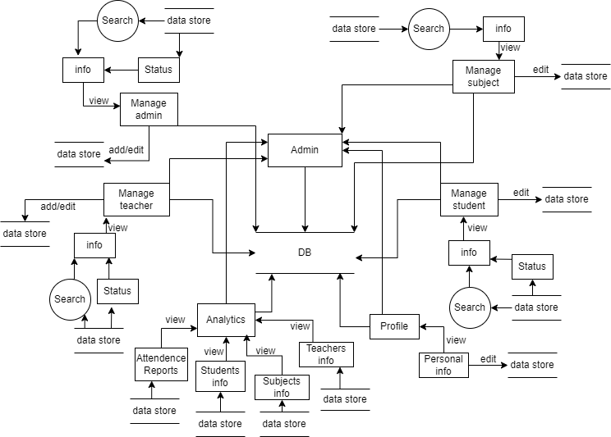
Data FLow Diagram
Fig: DFD level 2 for admin

Slide 17
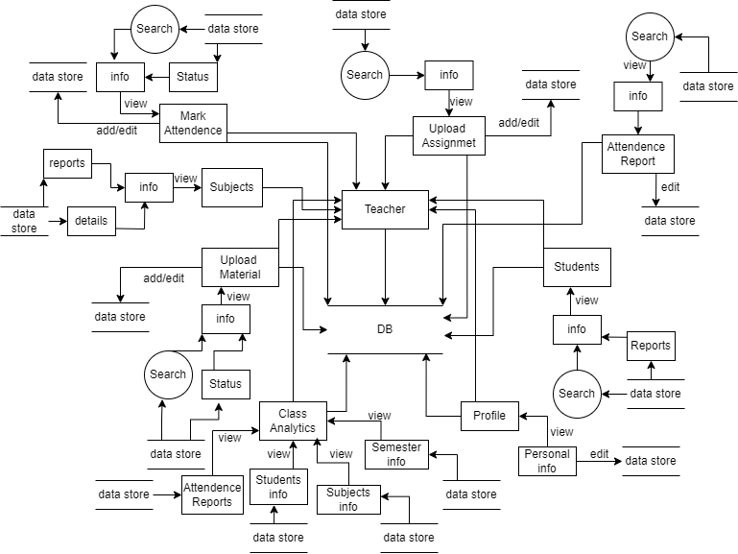
Data FLow Diagram
Fig: DFD level 2 for teacher

Slide 18
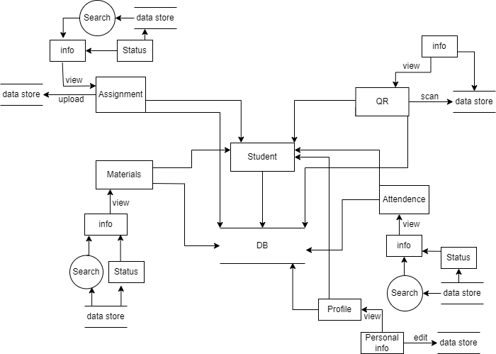
Data FLow Diagram
Fig: DFD level 2 for student

Slide 19
Technologies Used
Frontend: HTML5, CSS3, JavaScript ES6+, Bootstrap 5.3.0, Lucide Icons Backend: PHP 8.0+, MySQL Local Server: XAMPP (Apache + MySQL)
Device Registration: Token-based device registration system
Database: MySQL
QR Code System: HTML5 QR Code Scanner library
Real-time Features: JavaScript + AJAX
Data Visualization: Chart.js
Version Control: Git
Documentation: Markdown

Slide 20
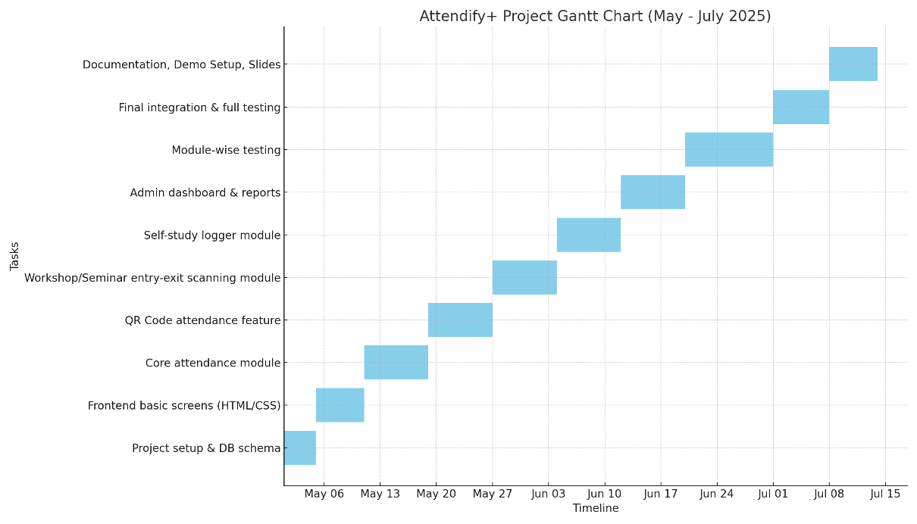
GANTT CHART

Slide 21
Project Results
Outcome:
Attendifyplus provides a secured and real time attendance tracking system for educational institutions with efficient and minimal effort.
Key Achievements:
Enabled real-time monitoring and tracking of attendance.
Generated accurate attendance reports with a single click.
Integrated QR code scanning for quick and secure attendance.
Designed a user-friendly interface for easy use and management.

Slide 22
Future Enhancements
Upcoming Features:
GPS Integration for Location Verification.
Device Fingerprinting Upgrade.
AI-Powered Attendance Anomaly Detection.
Role-Based Mobile App Development.

Slide 23
THANK YOU

